Slide 1


Pylist – A Python-like List Implementation in C++
Presenter: Saurabh Yadav Reg No:- 12310243

Slide 2
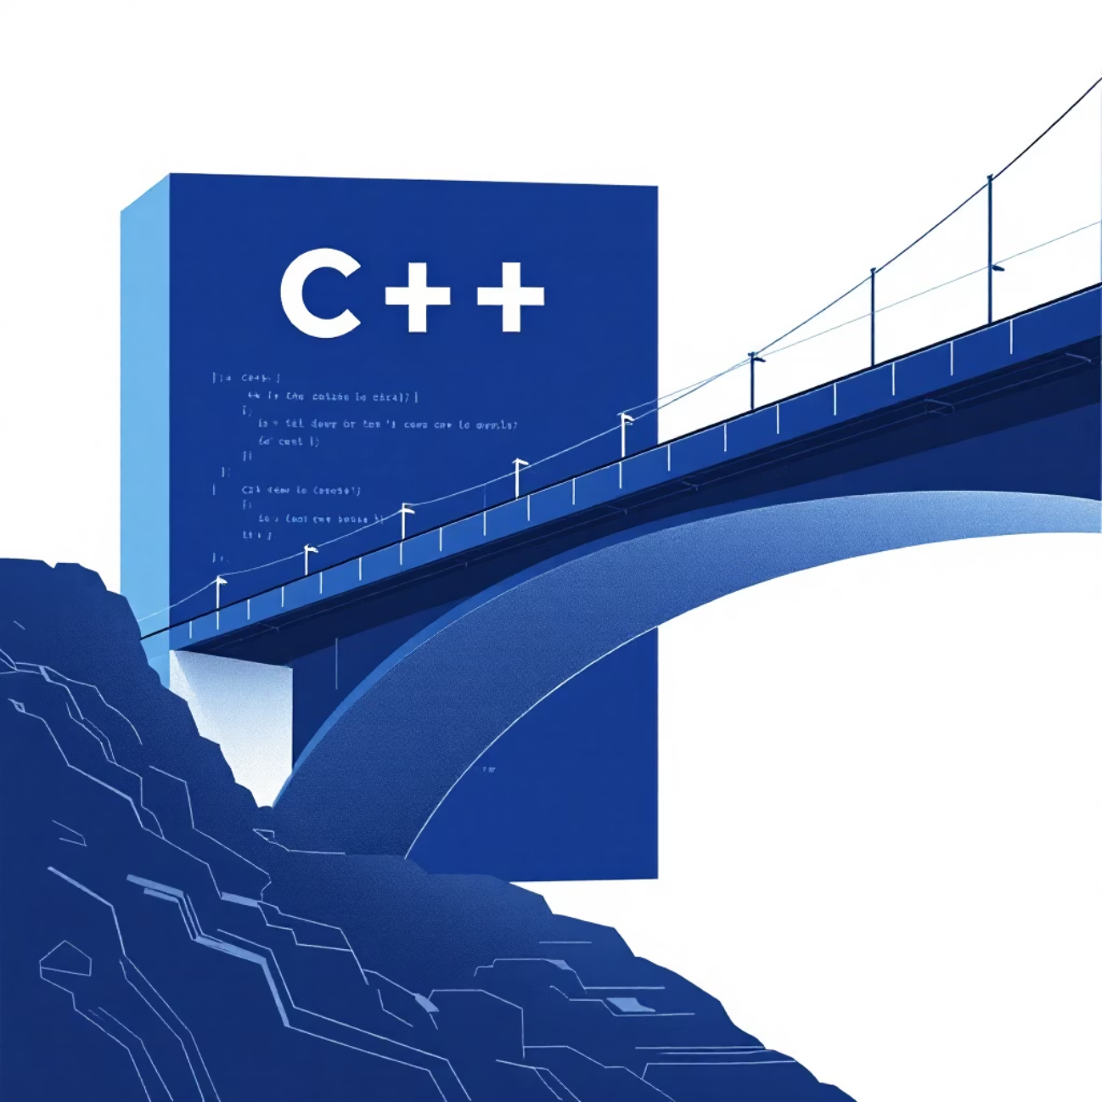
Introduction
The PyList project focuses on creating a custom C++ data type that accurately mimics the versatility and functionality of Python’s native list structure.
Python’s list is a powerful dynamic container that supports storing multiple data types and operations like append, insert, slice, and reverse.
In C++, such dynamic flexibility is not directly available with built-in containers.
This created an opportunity to deeply explore dynamic memory management and generic programming in C++.

Slide 3
Core Objectives: Why PyList?
Data Handling
Mimic Python list functionalities
Implement efficient access and indexing
Can store integers, floats, strings, or objects together — useful for programs needing mixed data types.
including append, insert, remove, pop, slice, reverse, and extend
using an internal mapping to enable O(1) access by index

Slide 4
Tools & Technologies
Language: C++
Concepts Used:
Classes & Objects
Dynamic Memory Allocation
Operator Overloading
Doubly Linked List
Enum Data Type
Unordered Map (for index mapping)
IDE: Visual Studio Code

Slide 5
Project Architecture
Main Components:
Class Pynode – Represents each node in the list.
Stores value and type (using enum Dtype).
Supports different constructors and assignment operators.
Class Pylist – The main list structure.
Maintains pointers to head and tail.
Stores nodes dynamically and provides list-like operations.
Enum Dtype – Defines data types like INT, FLOAT, STRING, etc.
Key Operations Supported:
append()
insert()
remove(), pop()
slice(), extend()
reverse()
operator overloading ([], <<, =)

Slide 6
Complexity Analysis of PyList Operations
Operation
Description
Time Complexity
append()
Add an element at the end of the list
O(1)
insert(index, value)
Insert element at any position
O(n)
pop()
Remove last element
O(1)
remove(index)
Remove element at specific index
O(n)
size()
Get number of elements
O(1)
clear()
Delete all elements
O(n)
reverse()
Reverse the entire list
O(n)
slice(start, end, step)
Create a sublist from start to end
O(k) where k = size of slice
extend(other_list)
Add all elements of another list
O(m) where m = size of other list
operator[] (indexing)
Access element at index
O(1) (using map)
display()
Print all elements
O(n)

Slide 7
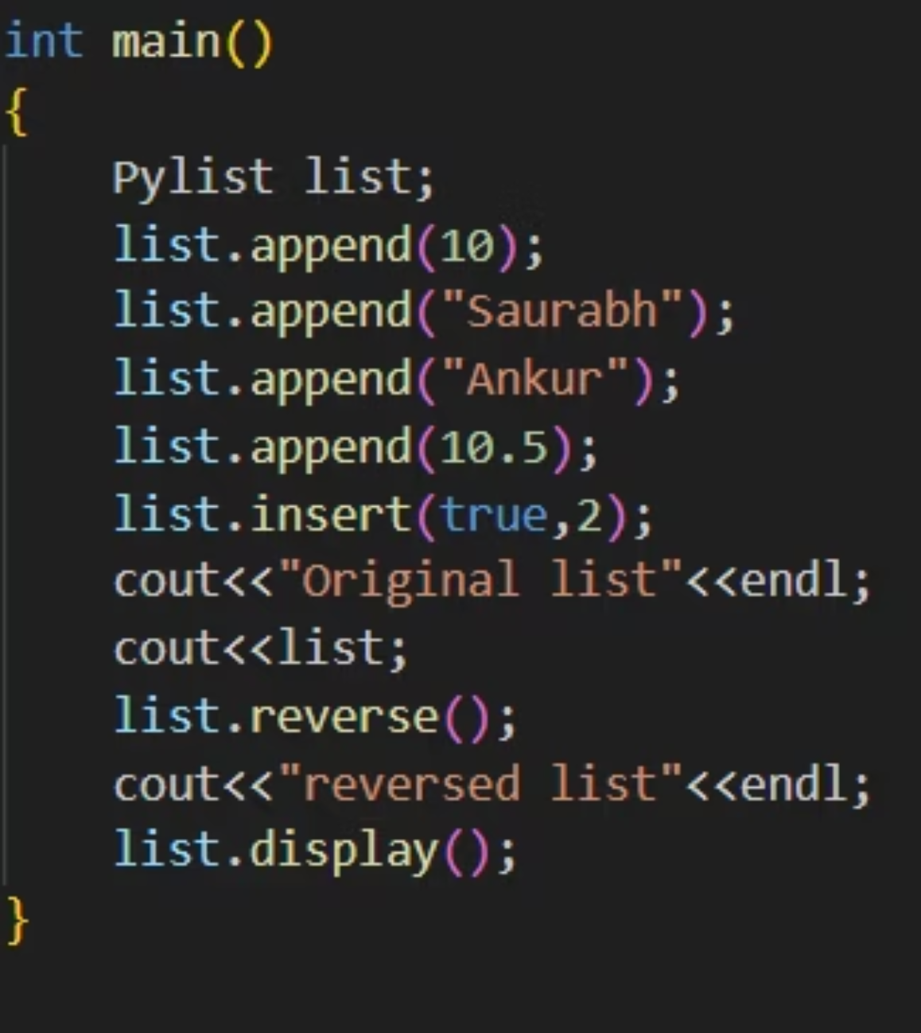
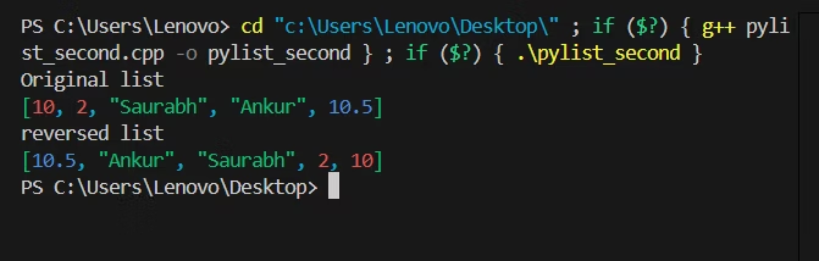
Example Execution

Slide 8





Key Implementation Challenges
Designing a structure to store multiple data types in one list.
Ensuring deep copies and safe dynamic memory handling.
Implementing efficient indexing with unordered_map.
Overloading multiple operators for smooth user experience.

Slide 9

Learnings
1
2
Improved understanding of Data Structures and Algorithms.
Learned practical application of Object-Oriented Programming (OOP).
3
4
Enhanced knowledge of operator overloading and memory management.
Experience in designing a custom reusable data structure.

Slide 10
Future scope
Integration with C++ STL: Pylist could become a standard container like vector or list.
Native Python-like list support: Programmers can use dynamic, multi-type lists directly in C++ without custom classes.
Enhanced productivity: Reduces the need for manual type handling and multiple container types.
Cross-language compatibility: Makes C++ more Python-friendly, especially for scripting or data-heavy applications.

Slide 11

Conclusion
Successfully created a Python-like dynamic list in C++.
The project demonstrates a solid grasp of DSA and OOP principles.
Pylist serves as a bridge between C++’s static typing and Python’s flexibility.

